Slide 1
Language Access
as a form of Community Engagement
Laura Gonzales, Ph.D.

Slide 2
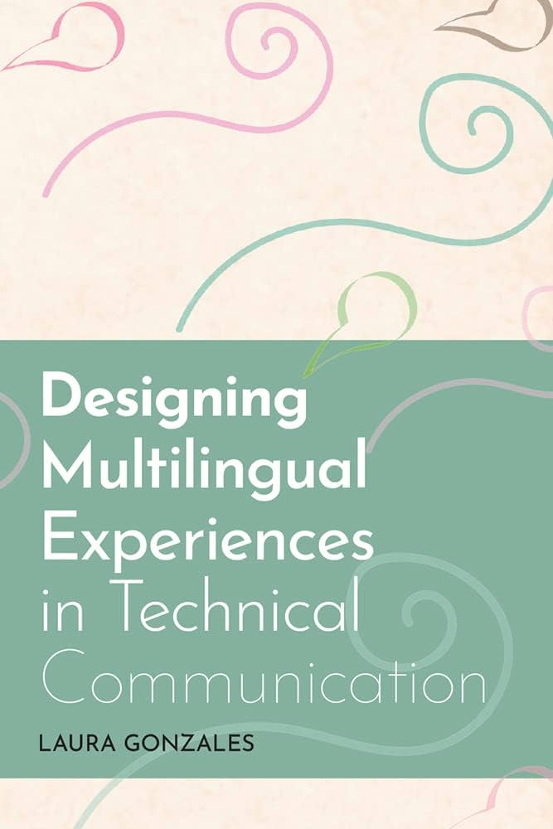
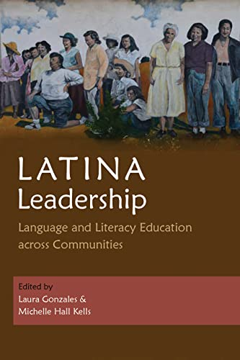
¡Buenos días!
I’m Dr. Laura Gonzales, and I’m passionate about helping people communicate effectively in multiple languages.
Immigrant from Santa Cruz, Bolivia
Learned to speak English at age 9, and that experience shaped who I am as a researcher, community member, and teacher
15 years experience as a translation project manager, translation researcher, collaborator
Conducted research on translation in Florida, Texas, Michigan, Guatemala, Mexico, and Nepal

Slide 3
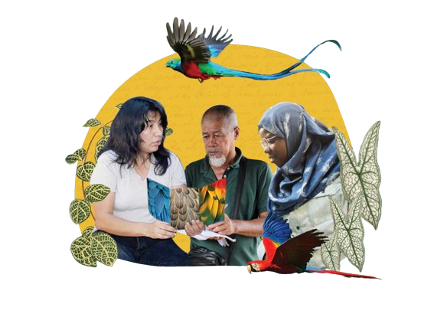
What does it look like for you to feel included? What does it sound like? Feel like?
Inclusion should be intentional. It’s not enough to just “welcome” or “invite” everyone

Slide 4
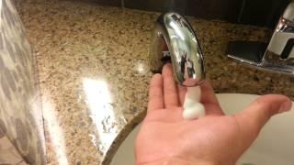
Exclusion by design
“What's actually happening: According to Richard Whitney, VP of product at Particle, the soap dispenser uses near-infrared technology, which sends out invisible light from an infrared LED bulb for hands to reflect the light back to a sensor. The reason the soap doesn't just foam out all day is because the hand acts to, more or less, bounce back the light and close the circuit. "If the reflective object actually absorbs that light instead, then the sensor will never trigger because not enough light gets to it," Whitney told Mic (Source).

Slide 5
How do we design to be intentionally inclusive?

Slide 6
What we’ll cover today
01
Policy
What laws govern language access work?
02
Numbers
How do we think beyond the majority?
Language = Participation
03
Stories
What can we learn from multilingual communities?
04
Strategies
How do we apply what we learned?

Slide 7
What we’ll cover today
01
Policy
What laws govern language access work?
Language = Participation

Slide 8
When we think about language access, we consider compliance
“Persons with limited English proficiency must be afforded a meaningful opportunity to participate in programs that receive Federal Funds. Policies and practices may not deny or have the effect of denying persons with limited English Proficiency equal access to federally-funded programs for which such persons qualify.”
-Title VI of the Civil Rights Act of 1964

Slide 9
When we think about language access, we consider compliance
“Each Federal agency shall prepare a plan to improve access to its federally conducted programs and activities by eligible LEP persons. Each plan shall be consistent with the standards set forth in the LEP Guidance, and shall include the steps the agency will take to ensure that eligible LEP persons can meaningfully access the agency’s programs and activities.”
-Executive Order 13166. Read the full order here

Slide 10
When we think about language access, we consider compliance
“Title II requires that State and local governments give people with disabilities an equal opportunity to benefit from all of their programs, services, and activities (e.g., public education, employment, transportation, recreation, healthcare, social services, courts, voting, and town meetings.”
-Americans with Disabilities Act

Slide 11
What we’ll cover today
02
Numbers
How do we think beyond the majority?
Language = Participation

Slide 12
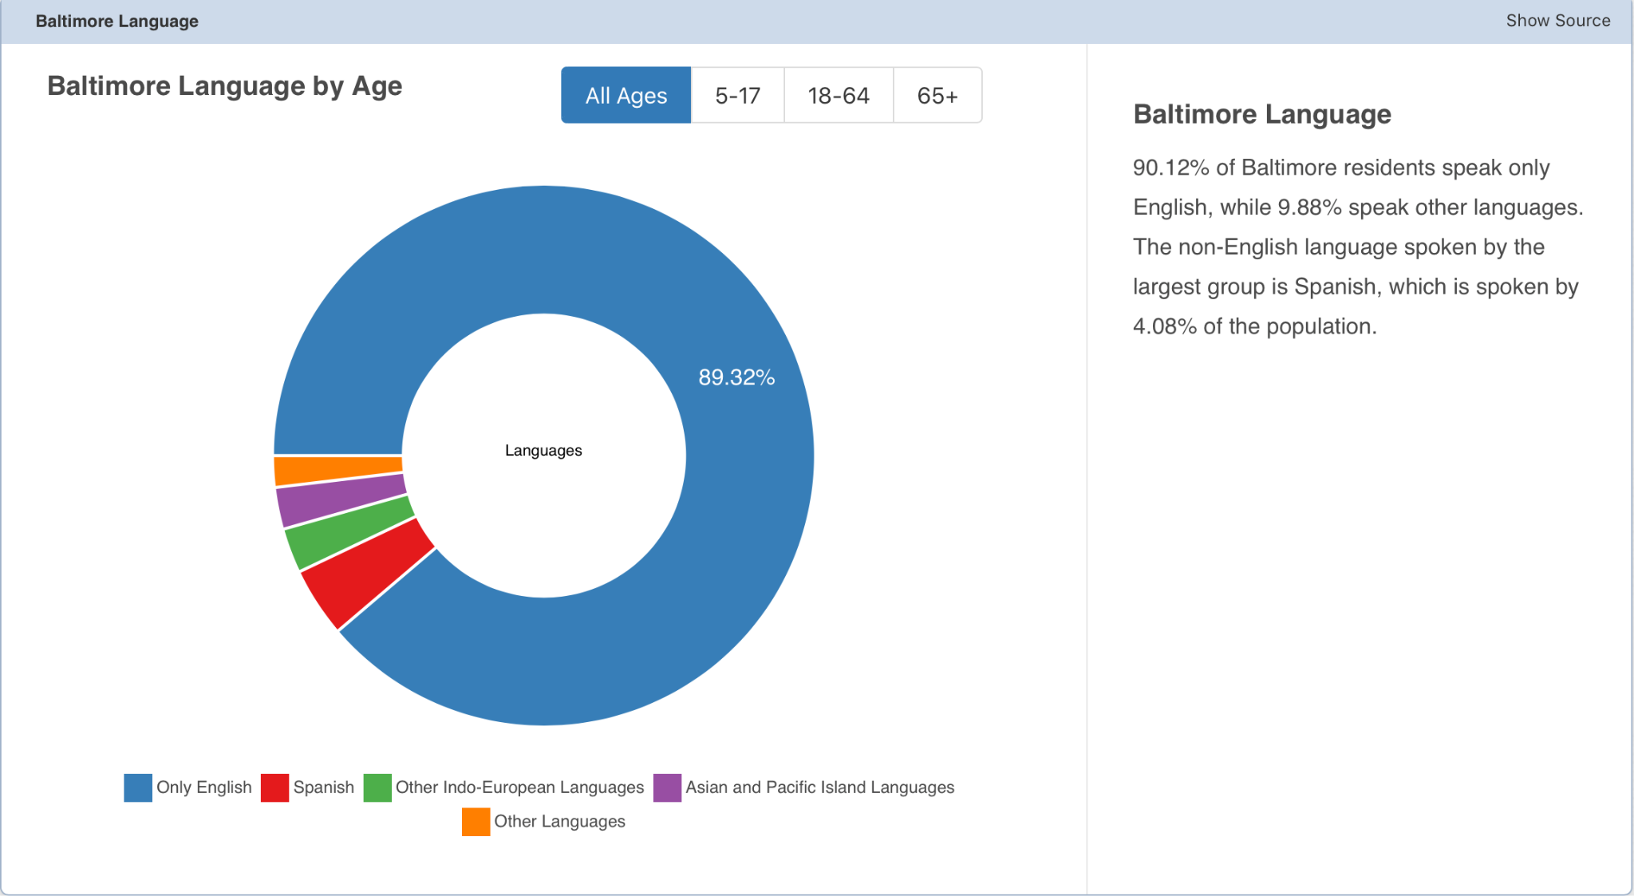
Language Access means thinking beyond the majority
Baltimore population: 585,708.
This means that there are over 57,000 multilingual community members in Baltimore
How many families? How many stories?

Slide 13
Datafication of injustice: “The hunt for more and more data about things we already know much about”
“We should ask ourselves whether research is serving as a stall tactic so we never collectively act on what we already know when it comes to engendering health and well-being”
-Ruha Benjamin, 2022

Slide 14
To learn about your community, consider:
What are the touchpoints for your organization/event? Where and how will people need to engage with you, and with each other?
Who are you envisioning at these touchpoints? Are multilingual people considered? Who is included/excluded?
It’s unlikely that you’ll be able to provide translation into every language for every touchpoint. But, where can you start this year? This month? This week?

Slide 15
Engagement by numbers
If your population is 10% immigrant or multilingual, is 10% of your marketing budget committed to multilingual outreach?
If you are providing interpretation and translation services, how are you letting people know these services are provided? How are you keeping track of who uses these services?

Slide 16
What we’ll cover today
Language = Participation
03
Stories
What can we learn from multilingual communities?

Slide 17
Asking people about their language means asking about their heart
What does language mean?
Connection
Passion
Participation
Including people’s preferred language extends the opportunity for connection
Language learning experiences often connect to immigrant’s passions and dreams
Language opens or closes entry points for participation

Slide 18
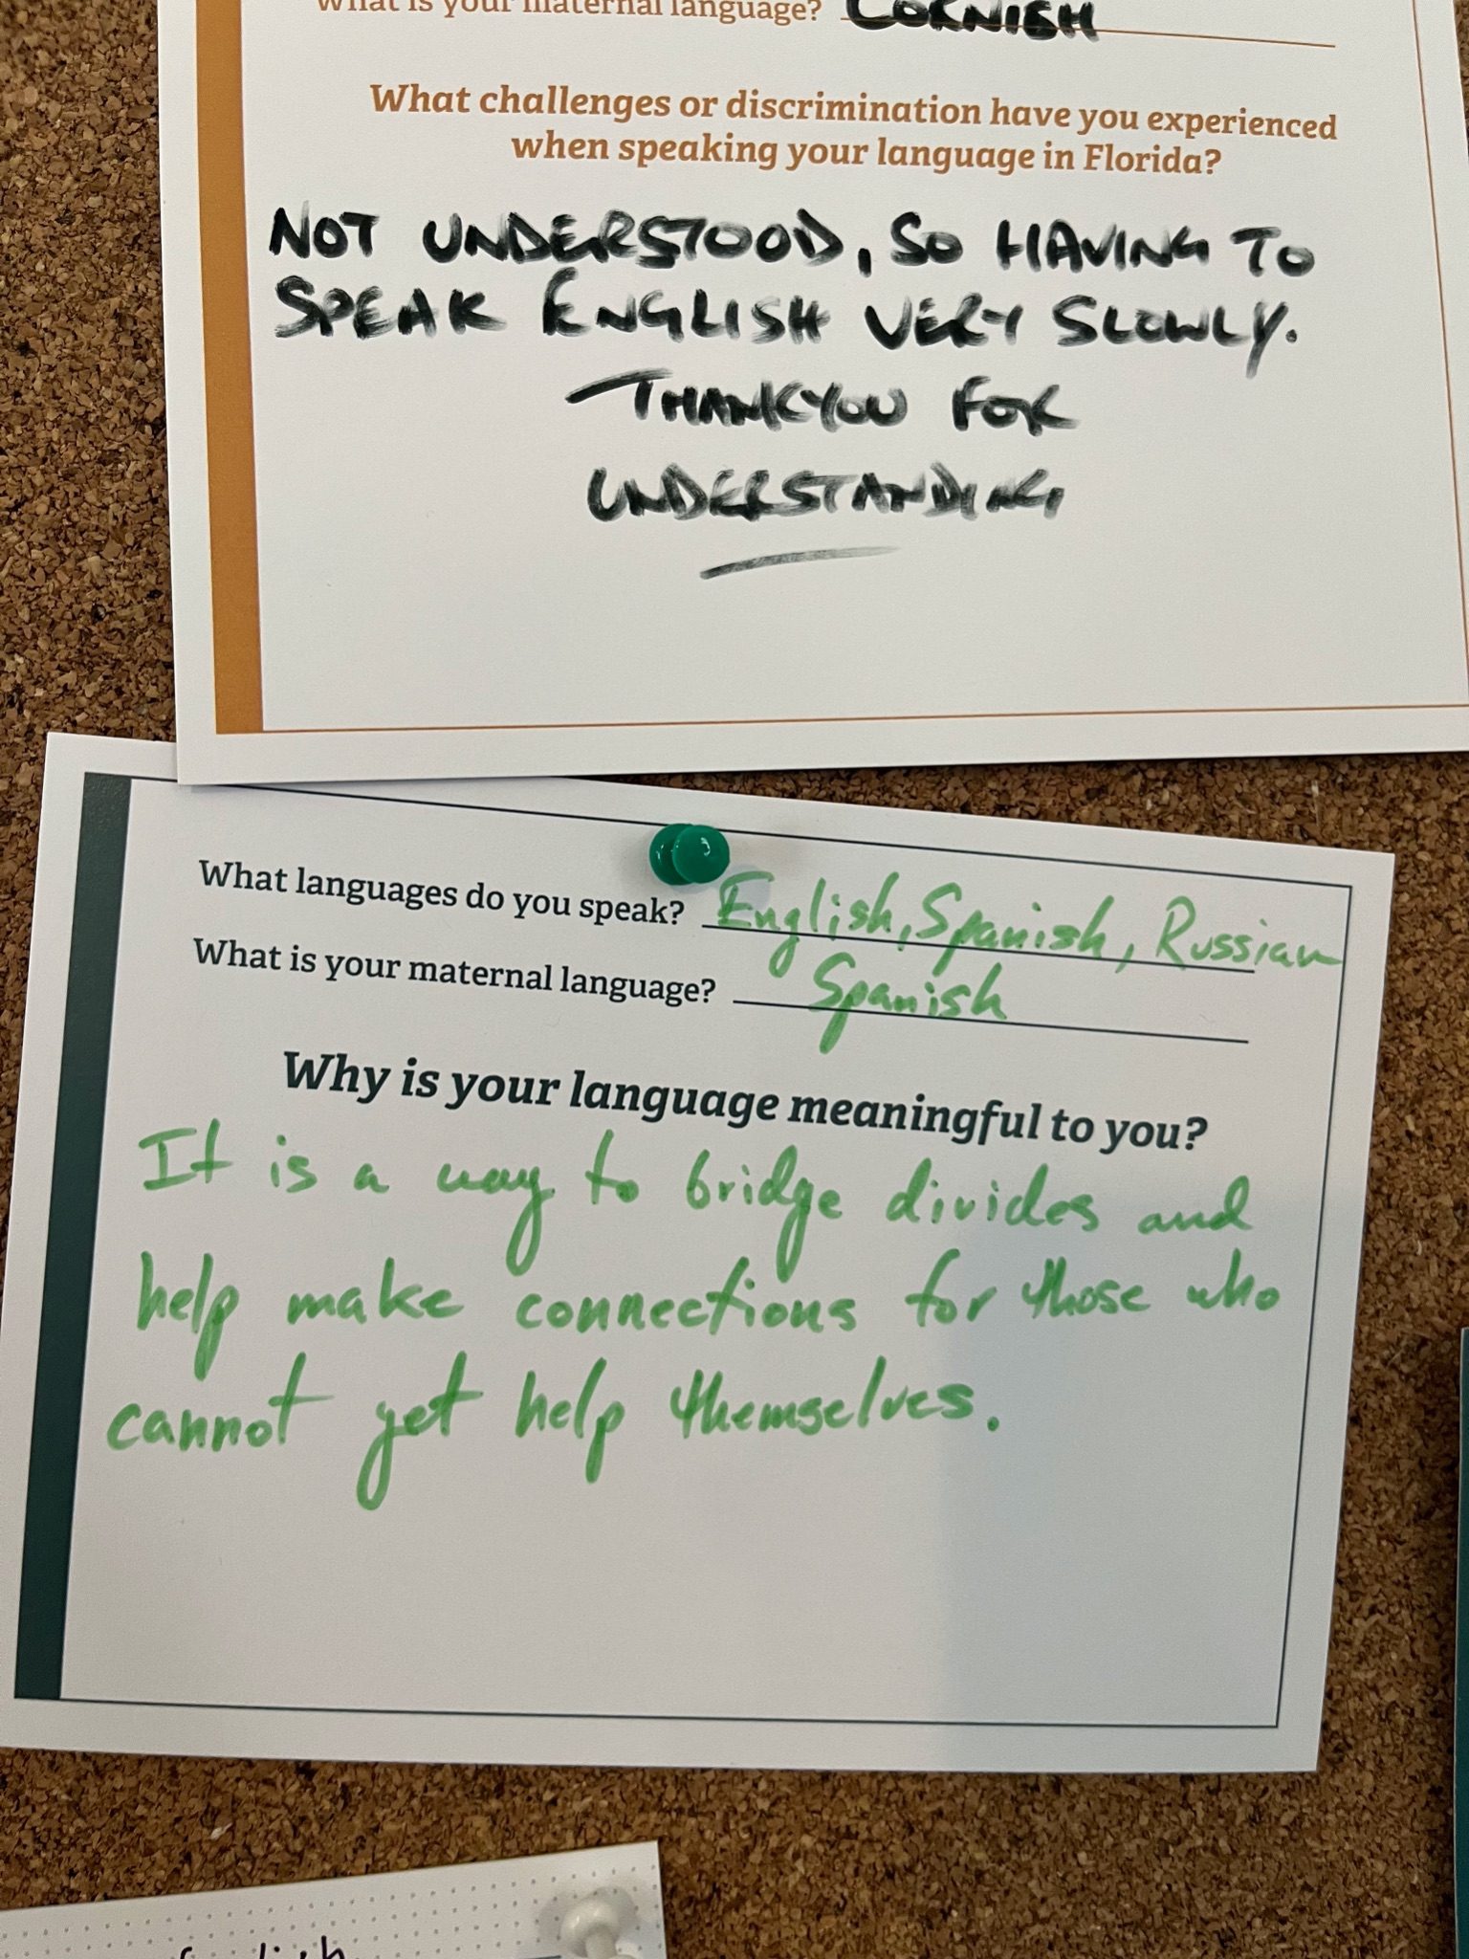
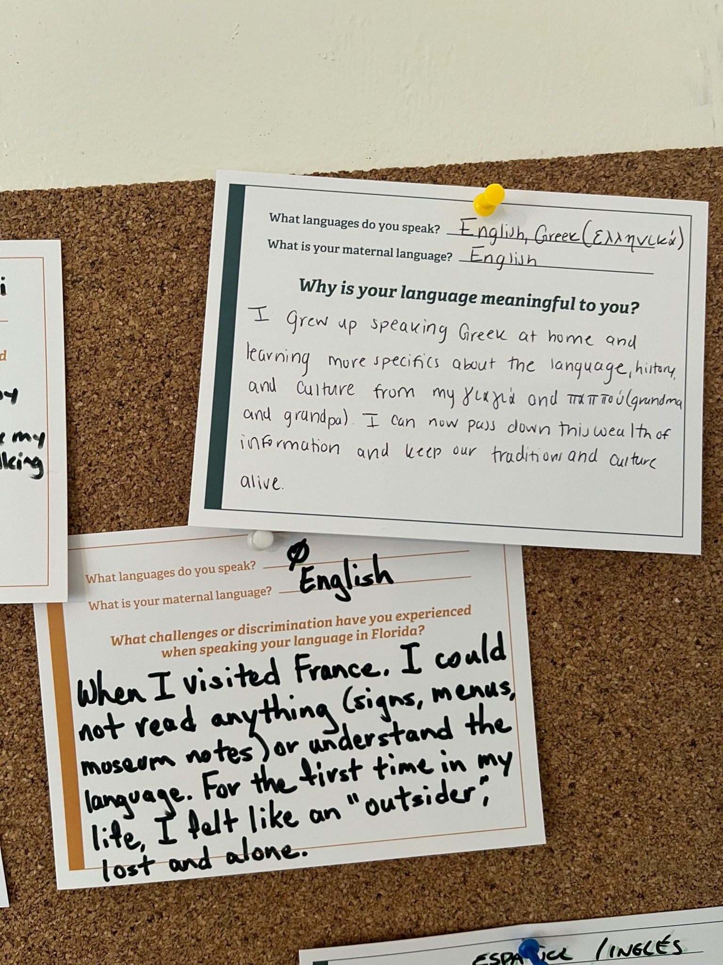
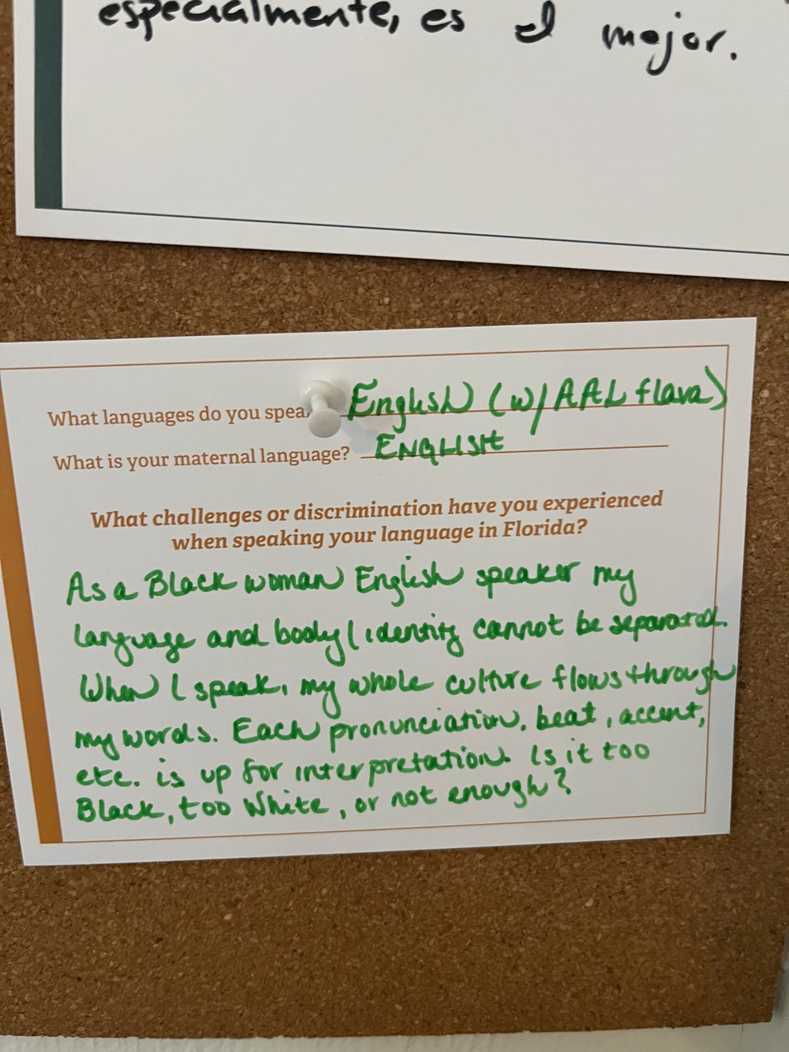
Our experiences are based on our positionalities (how the world sees us) and identities (+how we might see ourselves).

Slide 19
“The eagle reminds me of home and my language. It’s a symbol my mom always used as a language of strength and power. Whenever I see that bird, it reminds me of her, and that means I think about home”
Akuapem Twi, Ghana

Slide 20
“The eagle reminds me of home and my language. It’s a symbol my mom always used as a language of strength and power. Whenever I see that bird, it reminds me of her, and that means I think about home”
Aymara and Spanish, Bolivia
Vietnamese, Vietnam

Slide 21
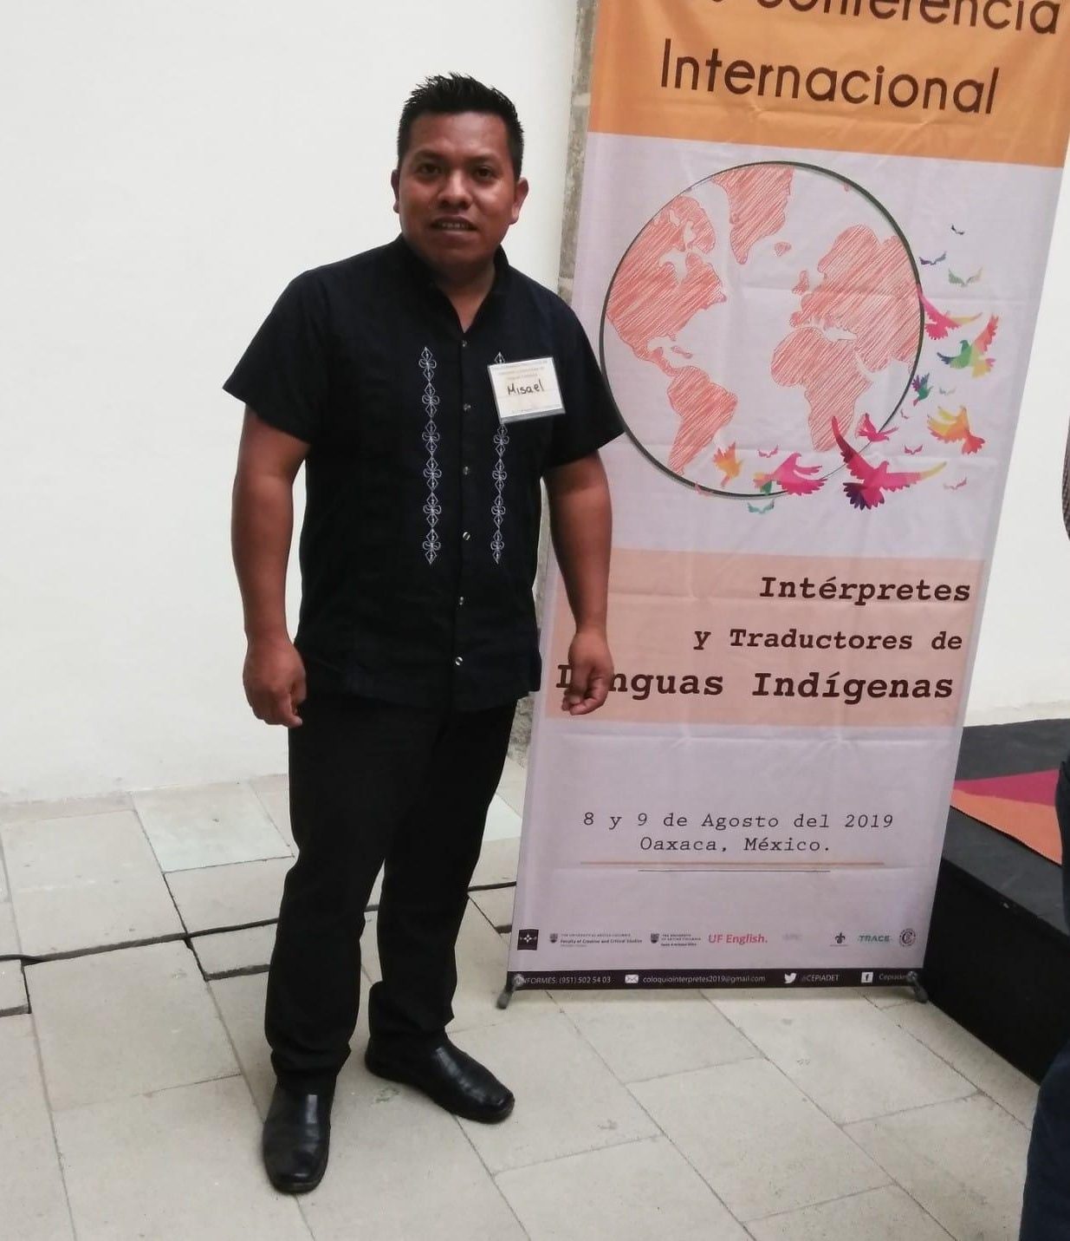
“When an Indigenous brother comes to a court hearing facilitated by the state government, instead of feeling confident, he feels scared, terrified, and no matter how much he may want to express that he agrees with or doesn’t agree with, he won’t do it. Why? Because of the space he’s in and the people he’s around.”

Slide 22
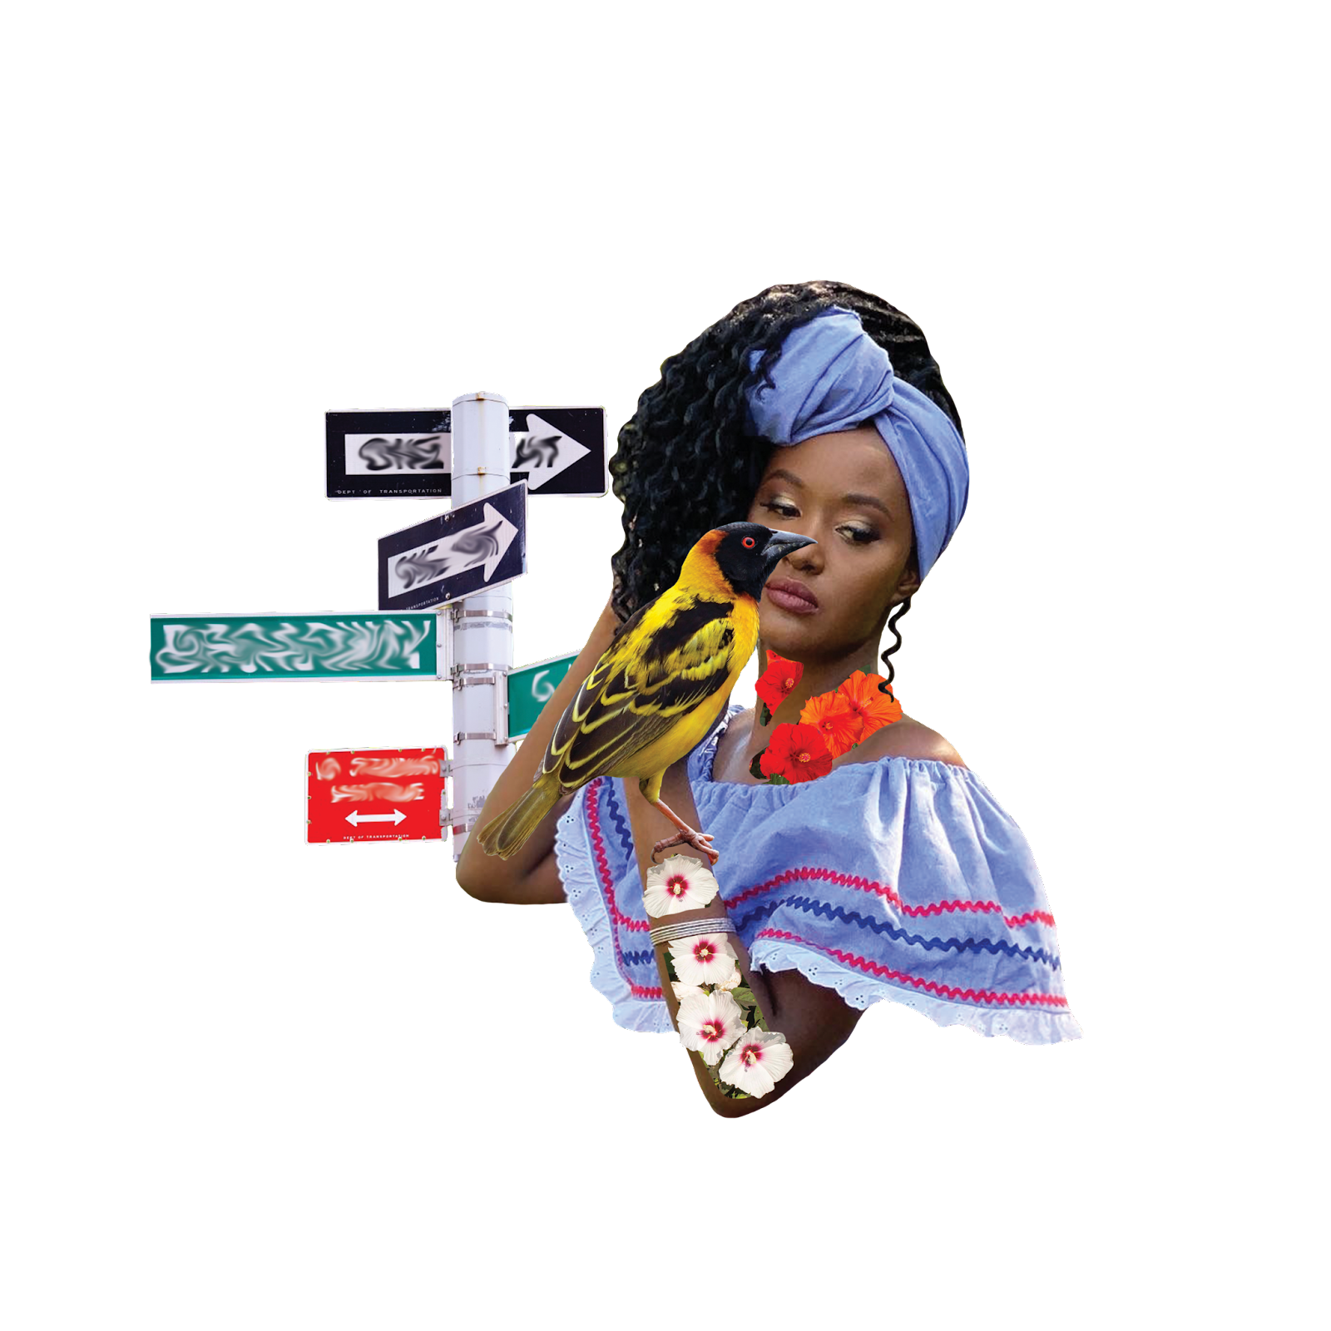
“Even though as a translator, you’re a professional, when you come into a white space, anti-Blackness continues. You are treated like you are lazy, like you don’t know what you’re doing. People want you to finish a translation quickly and to not take too long to interpret, all while you’re just trying to do your job.”

Slide 23
A multilingual space can still be a very white space. (How) is this inclusive?
“Linguistic hierarchies and racial hierarchies are interconnected. That is, people’s language experiences are not separate from their racial experiences. Indeed, the way a Black child’s language is devalued in school reflects how Black lives are devalued in the world” (p. 2).
-Dr. April Baker-Bell, Linguistic Justice: Black
Language, Literacy, Identity, and Pedagogy

Slide 24
Language is a site for pain, joy, struggle, dreams, ambitions, questions, reflections, and more!

Slide 25
What we’ll cover today
Language = Participation
04
Strategies
How do we apply what we learned?

Slide 26
Access versus participation
Access means that I have the ability to understand information or attend an event.
Participation means that I feel comfortable in the space, and that I can speak back to what is being communicated to me.

Slide 27
Access
Agency
Client
Client
Client

Slide 28
Participation
Agency
Client
Client
Client

Slide 29
Components of Language Access
Translation
Interpretation
Making written information accessible
Translating information verbally. Can be simultaneous or consecutive
Outreach
Engagement
Connecting with multilingual community members
Sustaining two-way communication with community members

Slide 30
Scenario: How do we improve participation?
For a city council meeting, the city brings in interpreters to facilitate communication between council members and constituents. The council members feel good that they remembered to bring in interpreters. The council members assume that because interpreters are present, constituents will automatically feel comfortable sharing their ideas, but this isn’t the case. Their errors begin with their first interaction with the interpreters. Instead of interacting with the interpreters and introducing them, the city council members just begin talking. They talk quickly and don’t pause, and the interpreters scramble to keep up. One interpreter has to interrupt the council member to slow down, but the council member quickly forgets and resumes their former pace. The constituents watch this unfold and begin to distrust that the interpretation is full and accurate. When the council opens the floor for questions, one community member asks a question and the interpreter mediates. When the council member answers, instead of looking at the constituent, they look at the interpreter. Like many interactions with white people, the constituent feels ignored and rendered invisible. Feeling disrespected, the constituent doesn’t come back. The council member is oblivious to the harm that they did and never follows up about how that interaction went and what they could have done better.

Slide 31
Participation Requires Planning
A language access plan is a document that spells out how to provide services to individuals who do not speak English or have limited English proficiency. Language access plans should be tailored to individual organizations, but may include similar sections.
Find a sample Language Access Plan template here.

Slide 32
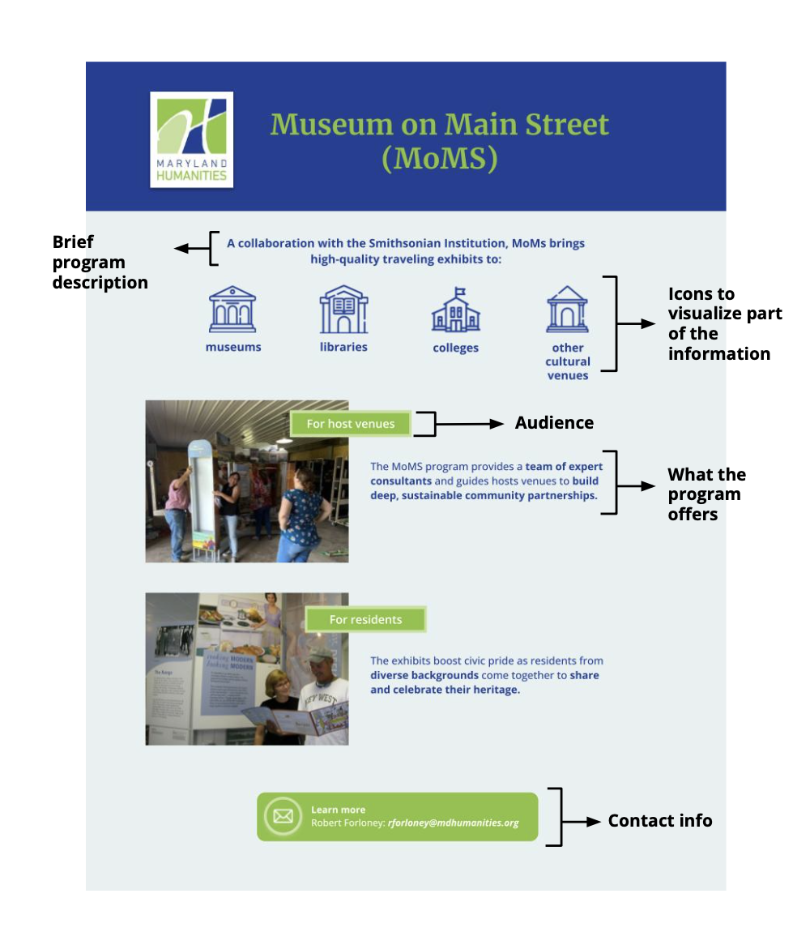
Develop templates to prepare documents for translation
Visuals
Simplified language
Critical information

Slide 33
Planning for translation
How will someone get help in your organization in languages other than English?
What documents will you prioritize for translation?
At what events will you provide interpretation, and into what languages?
Language Access Budget Guide

Slide 34
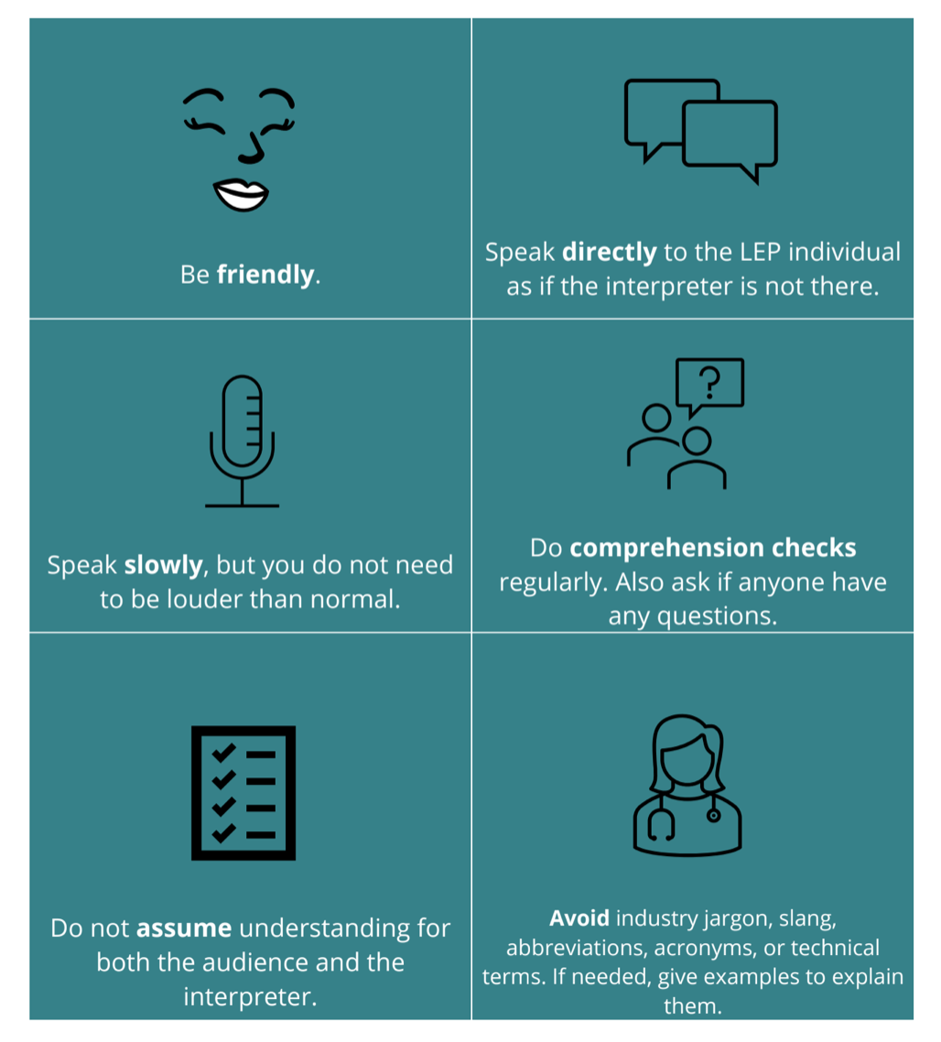
Working with interpreters

Slide 35
When measuring engagement, consider:
What sector is your agency/organization in? (e.g., education, health, safety)
Are your services for everyone in the community, or just specific groups?
How do your engagement numbers compare to the demographics of your city/county?
How are you targeting specific groups through your marketing and outreach strategy? Are there channels you haven’t considered?
How are you assessing engagement? Who are you accounting for (and not)?

Slide 36
Scenario: How do we improve participation?
Your organization is launching a new program for families. The program will take place in a local community center during the summer, and will provide youth and families with free lunch each day.
What should you consider in your access strategy?
Who may feel excluded from this programming?
How can you expand multilingual access in this program?

Slide 37
Examples of multilingual engagement
Collaborative translation
Ask people to provide a concept in their language that relates to the event. Have people describe these concepts using images, sounds, movement.
Listening sessions
Leverage connections at schools, churches, restaurants to advertise listening sessions in specific language. Listening sessions should have space for sharing stories (not just answering questions).
Everyone translates
Incorporating multilingual elements in your activity that are not translated into English can show English speakers what it feels like to not have language access.

Slide 38
¡Mil Gracias!
languageaccessflorida@gmail.com

